Slide 1







Investing in Hong Kong

Slide 2






Introdcution
Hong Kong is a famous global city and a major destination for Travellers looking for adventure, culture, and business.
People want to start a new life, work, or study. Because so many people are always looking for a place to stay, the property rental market is very active.
7. Conclusion

Slide 3



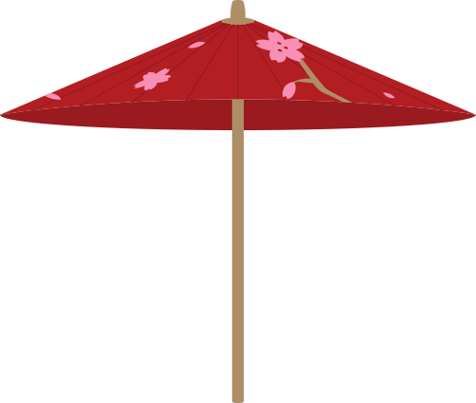
Aim
Which neighbourhoods offer the highest revenue potential?
Which property types are most expensive and profitable?
Where are the highest-rated listings located?
What are the cheapest options for budget travellers?

Slide 4





Audience
Real Estate Agencies & Investors: Seeking to allocate resources efficiently.
Property Managers: Interested in maximizing rental income.
Travelers: Looking for affordable and highly-rated accommodations.
Market Analysts: Studying trends in Hong Kong's short-term rental market.

Slide 5

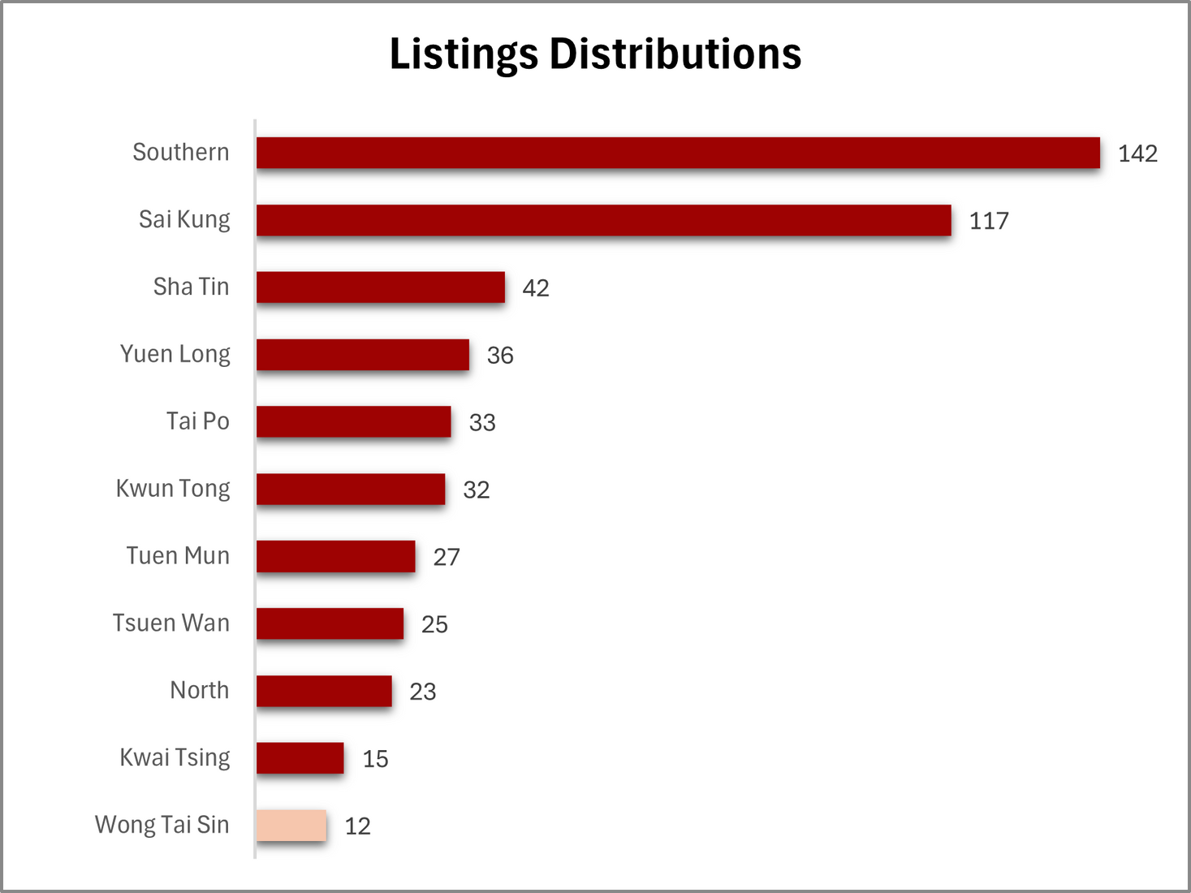

Listing Distribution
Listings

Slide 6
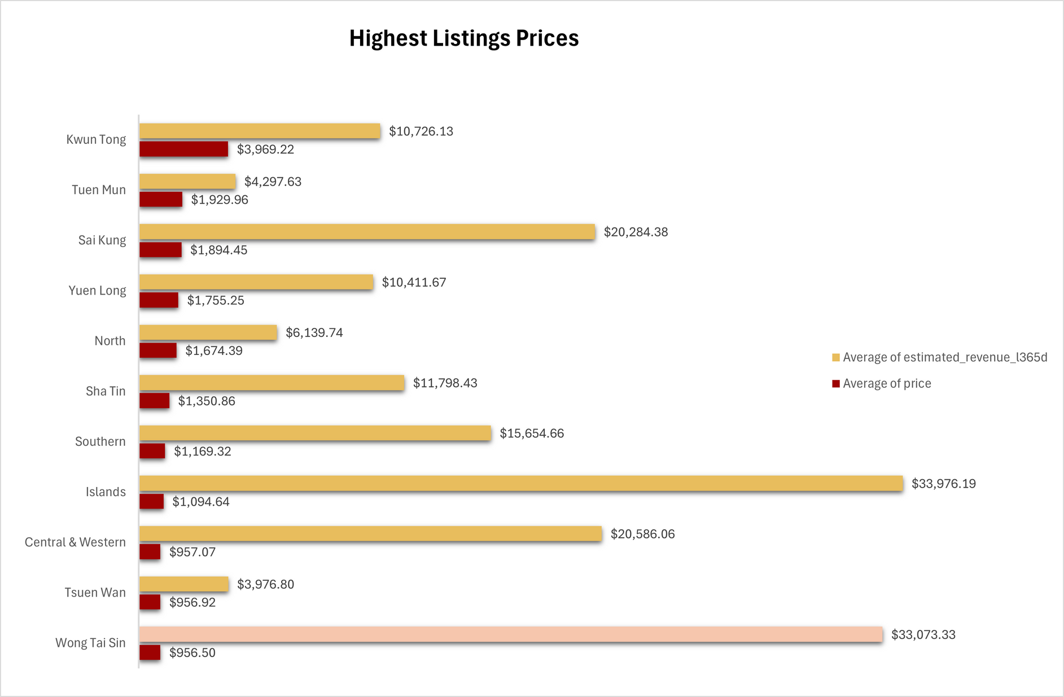
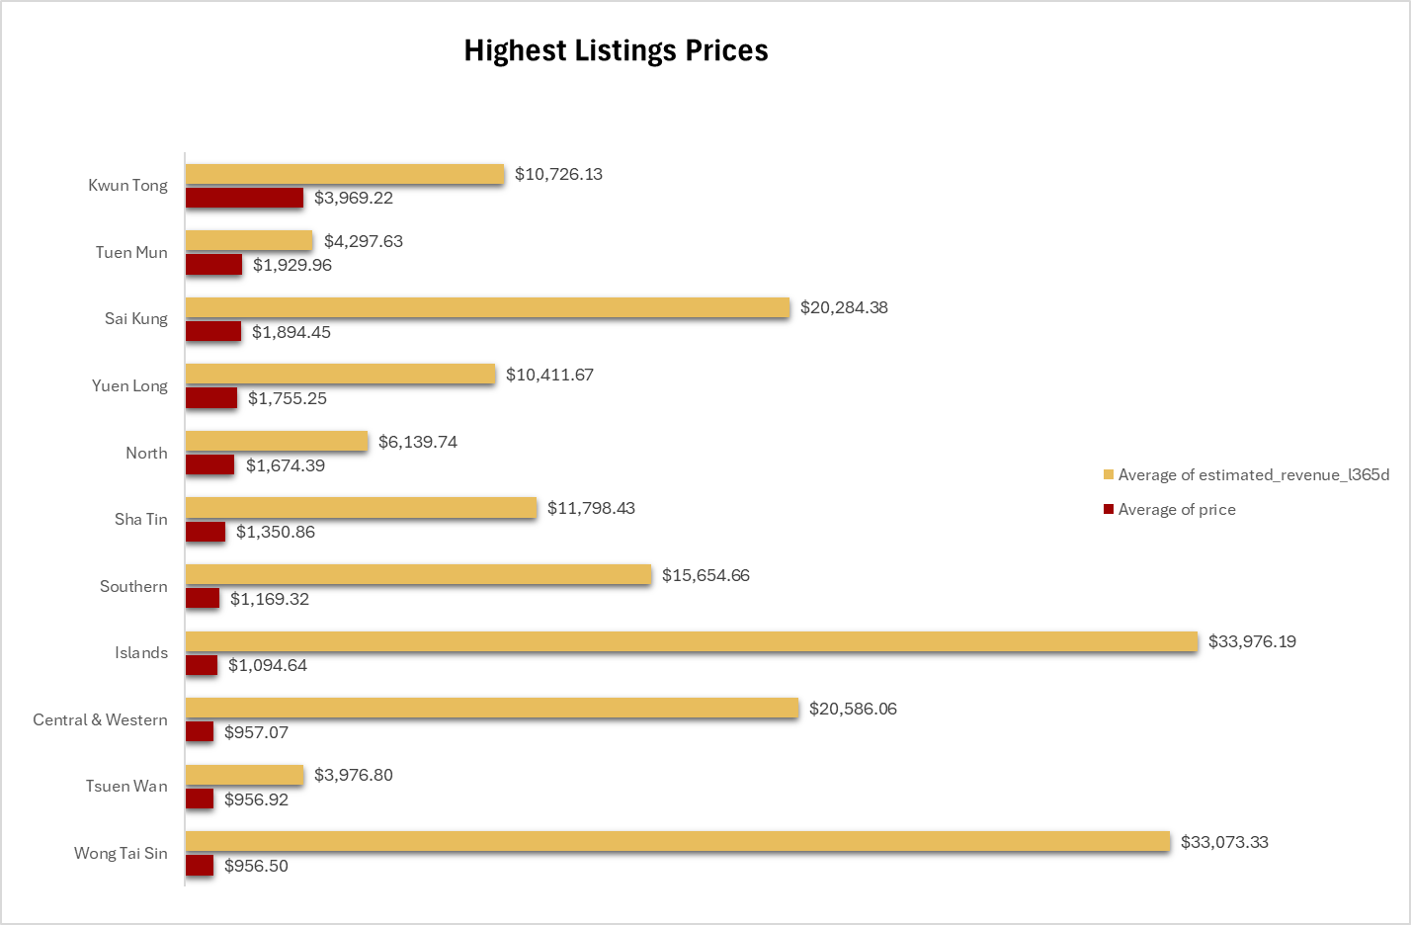
Highest listing prices
Revenue
Price

Slide 7
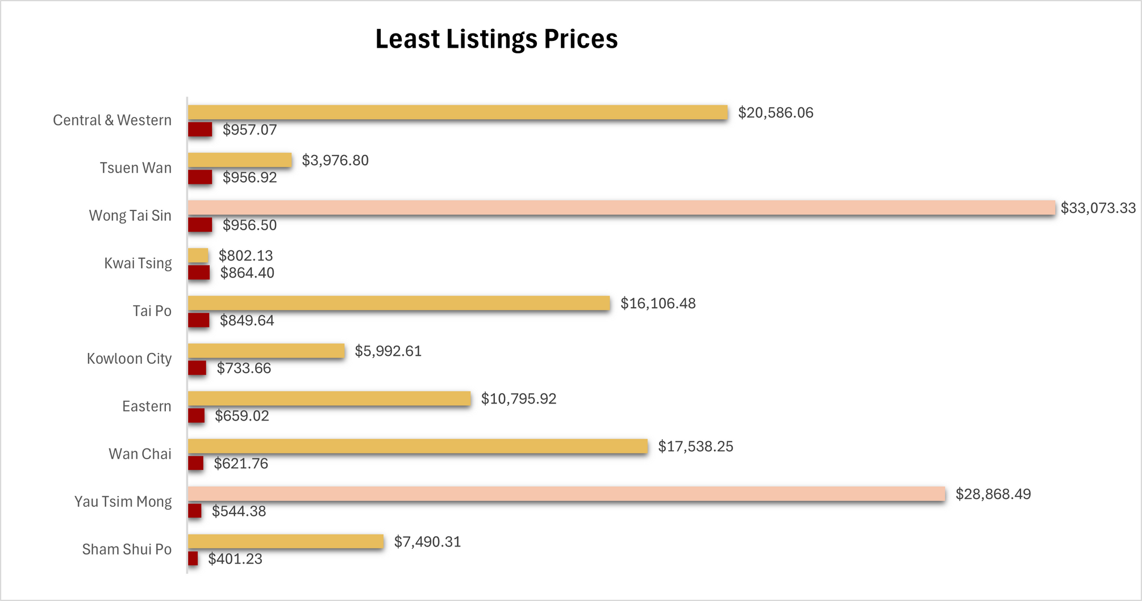
Least listing prices
Revenue
Price

Slide 8
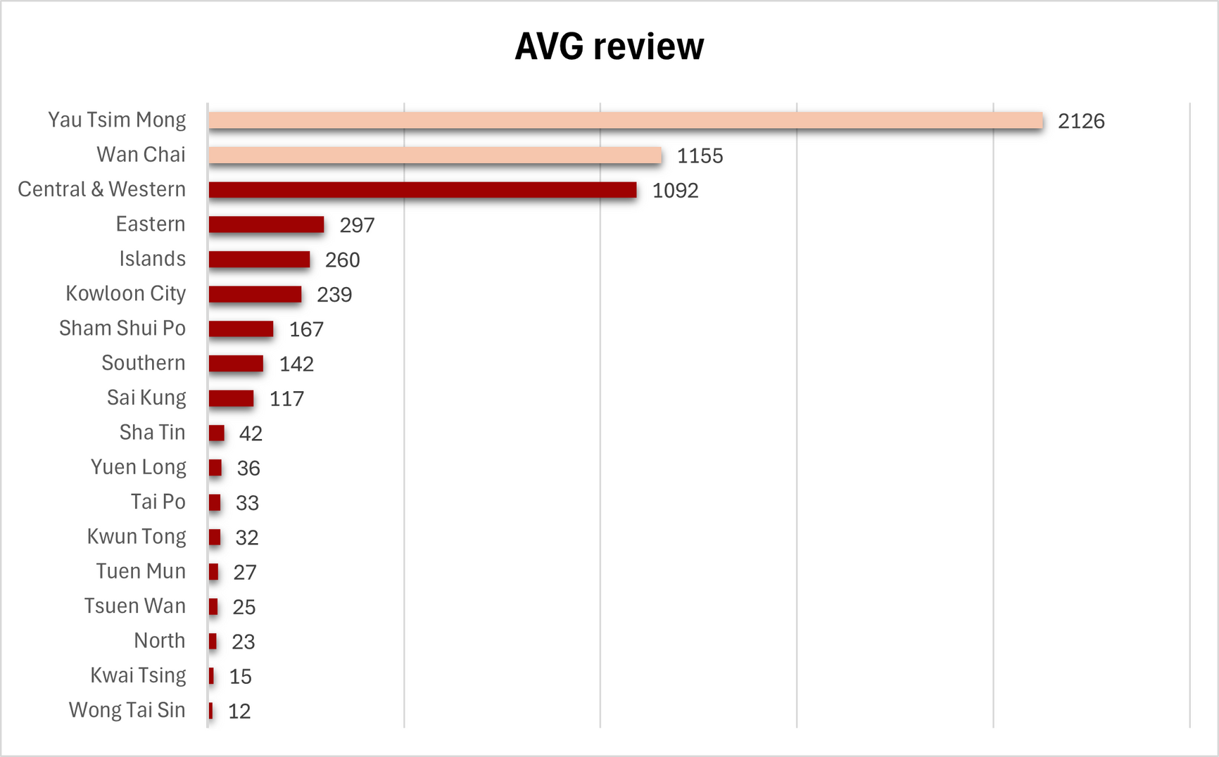
Average Review Days

Slide 9
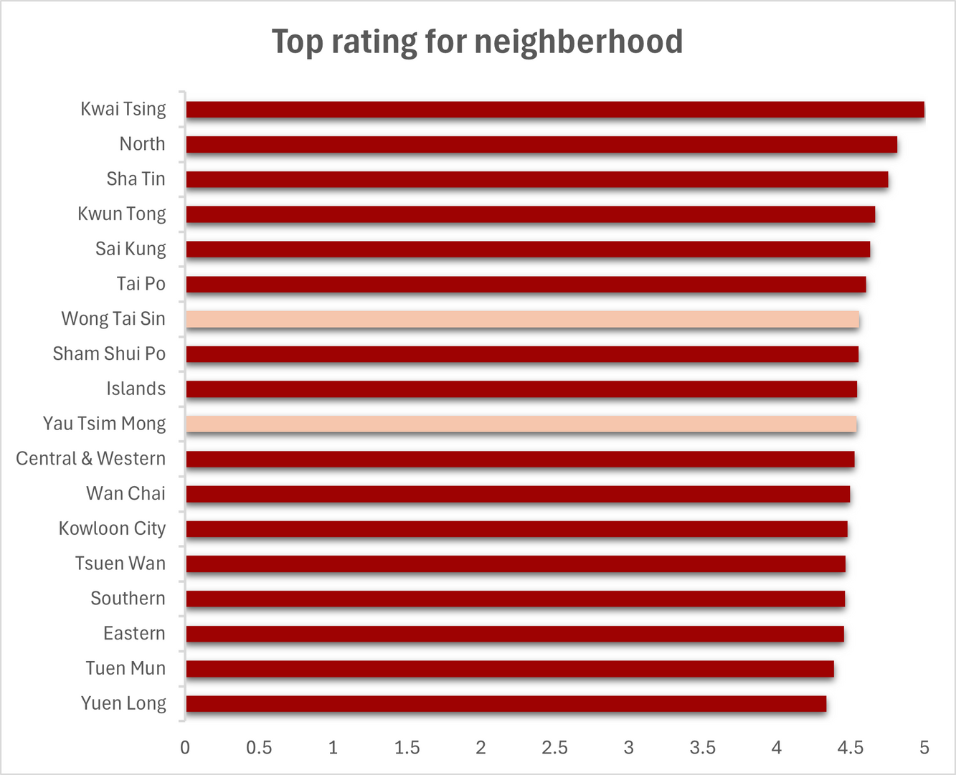
Top Neighberhood rating

Slide 10
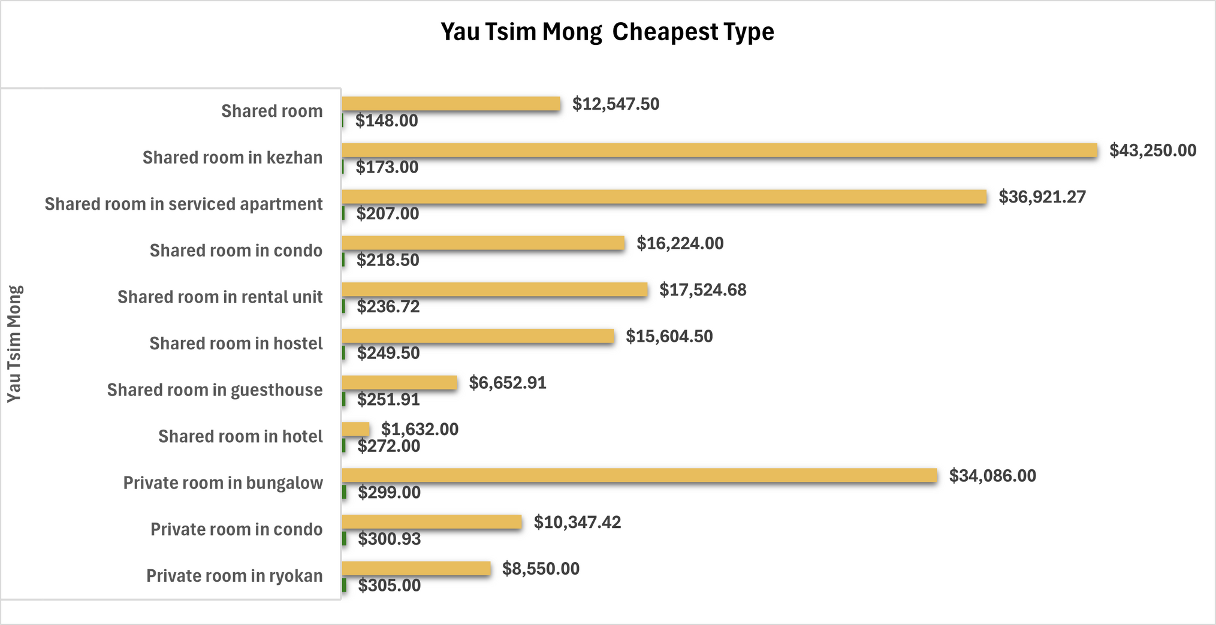
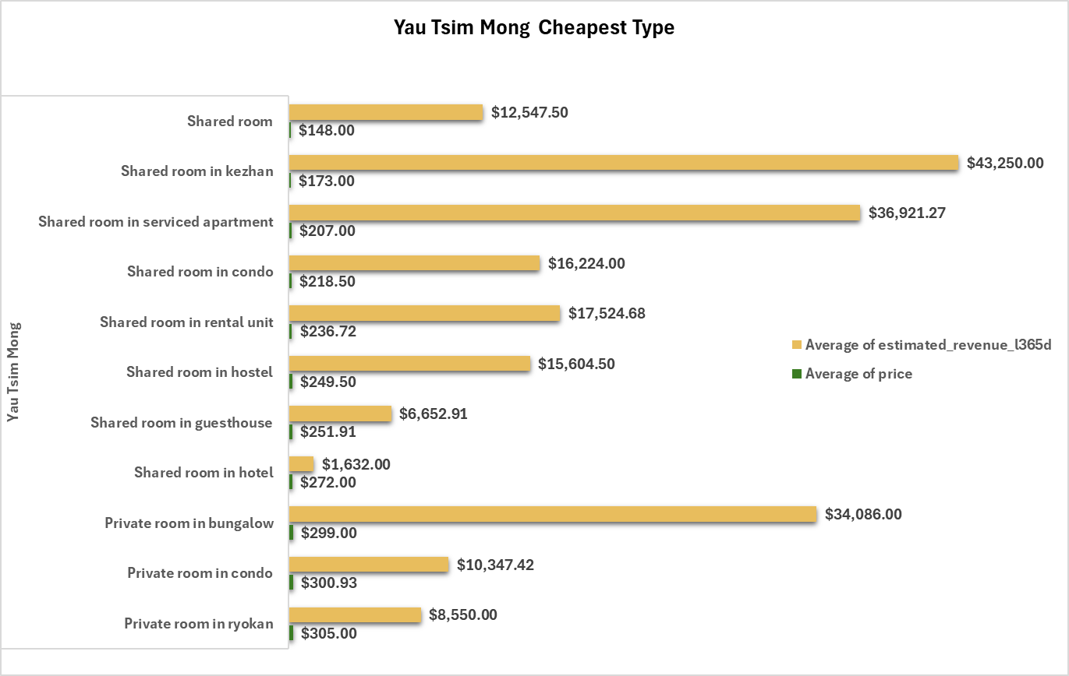
Yau Tsim Mong Cheapest Type
Revenue
Price

Slide 11
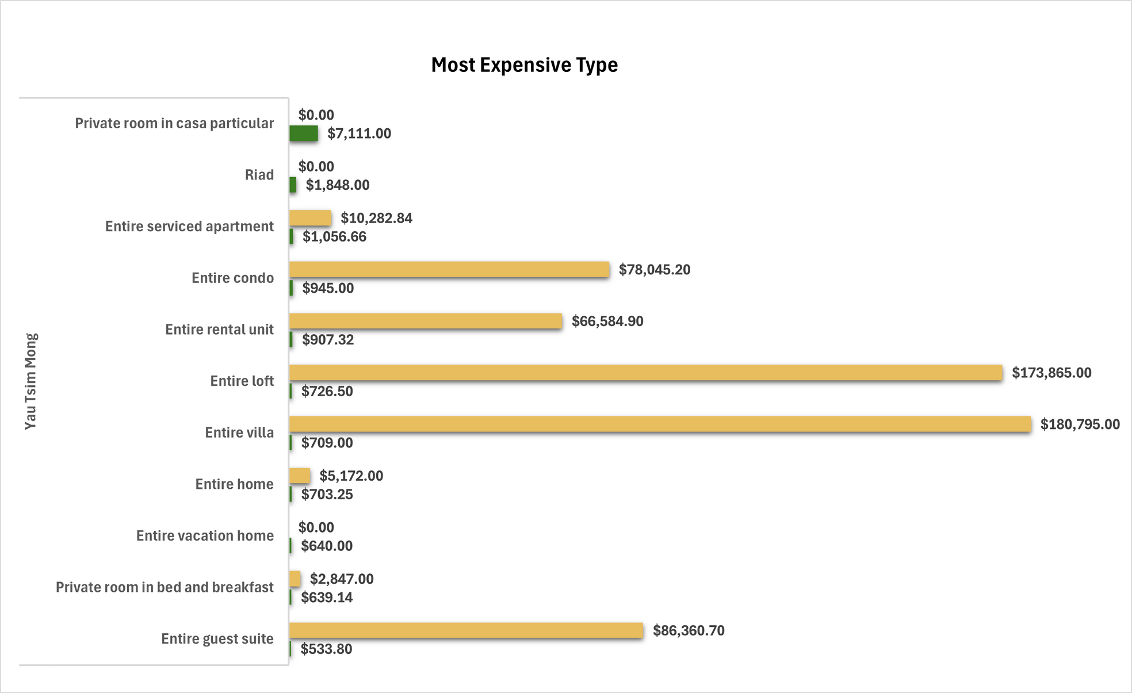
Yau Tsim Mon Most Expensive Type
Revenue
Price

Slide 12
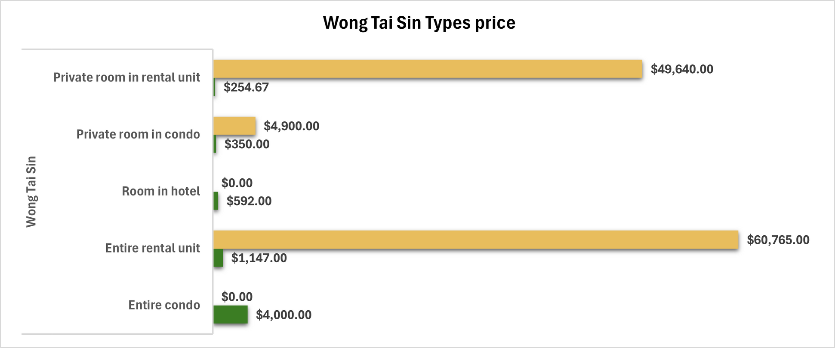
Wong Tai Sin prices per types
Revenue
Price

Slide 13
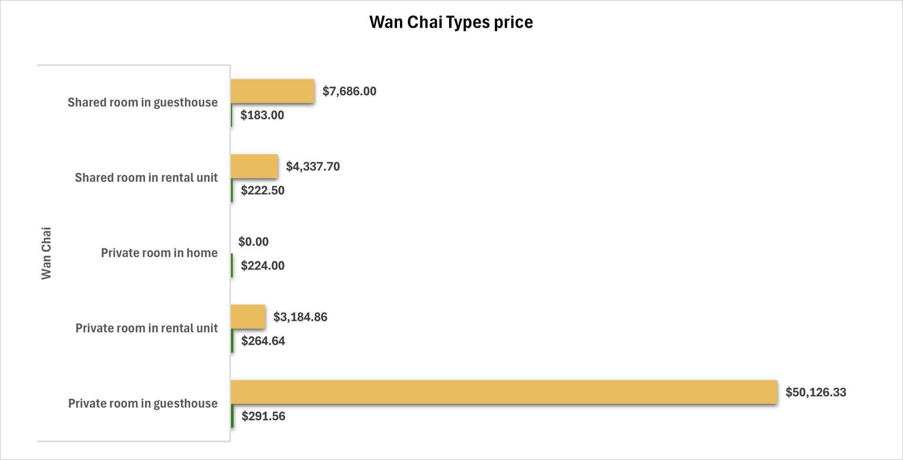
Wan Chai prices per types
Revenue
Price

Slide 14


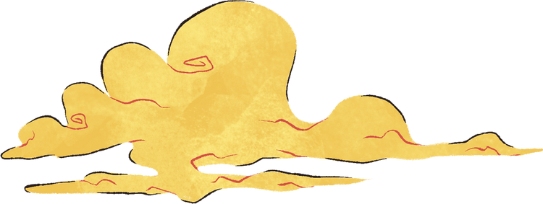

Recommendations - Investors
Islands
Revenue: Highest revenue ($33,976.19).
Reviews: Not explicitly listed in top reviews, but high revenue suggests consistent demand.
Wong Tai Sin
Revenue: Second-highest revenue ($33,073.33).
Reviews: Moderate review volume, but top ratings show quality.
House type: Entire rental unit, Private room in entire unit
Less Competition
Yau Tsim Mong
Revenue: Strong revenue ($28,868.49).
Reviews: Highest review volume (2,126 reviews), reflecting popularity and trust.
House type: entire Villah, Entire loft, Entire Guist suit
More competition

Slide 15

Recommendations - Travellers
Shared
Yau Tsim Mong
Price: Affordable shared rooms ($148/month).
Comfort: Highest reviews (2,126) and strong ratings (~4.5), guaranteeing reliability.
Wan Chai
Price: Affordable shared rooms ($183/month).
Comfort: Second-Highest reviews (1155) and strong ratings (~4.5), guaranteeing reliability.
Private
Wan Chai
Price: Affordable shared rooms ($224/month).
Wong Tai Sin
Price: Affordable shared rooms ($254/month).

Slide 16
Recommendations
(Travellers)
Budget Travellers:
Stay in Sham Shui Po or Yau Tsim Mong for the lowest prices.
Opt for shared rooms or private rooms in condos.
Quality Seekers:
Choose Islands, Sai Kung, or Sha Tin for high ratings.
Consider entire rental units or serviced apartments for comfort.
Location-Conscious:
Yau Tsim Mong and Wan Chai offer central locations at reasonable prices.

Slide 17

Conclusion
Investors should target high-demand, high-revenue areas with entire properties and less competition.
Travellers should prioritise review-rich, affordable zones with shared/private rooms, depending on their needs

Slide 18



Thank You

